Slide 1


Structure and function of the PNS
Vincenzo Mastrolia
Research Associate
Centre for Developmental Neurobiology (CDN)
King’s College London

Slide 2
Learning outcomes
Identify the 12 pairs of cranial nerves and 31 pairs of spinal nerves
Describe the formation of spinal nerves and describe the general principles of their distribution
Define the term ‘nerve plexus’
Define the terms ‘dermatome’ and ‘myotome’
Outline the basic organisation and functions of the autonomic nervous system
Differentiate between sympathetic and parasympathetic efferents
Highlight the control centres for the autonomic nervous system

Slide 3
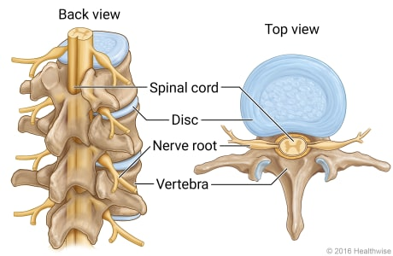
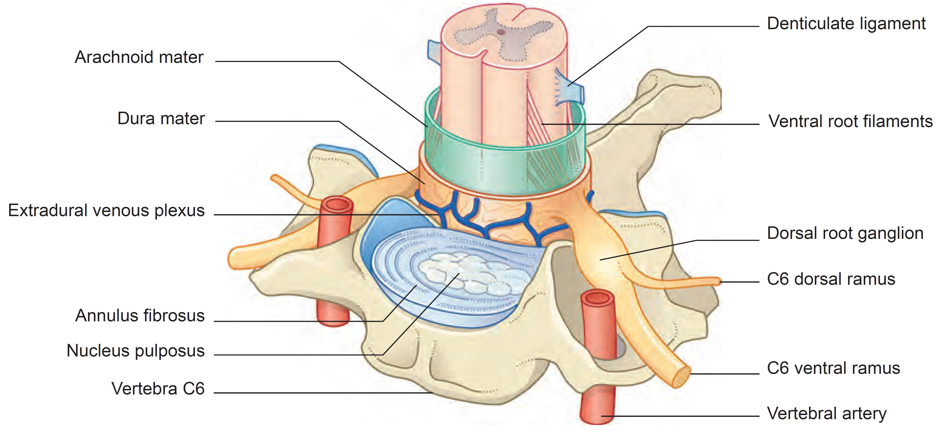
The spinal cord and the nerves

Slide 4
The spinal cord and body segmentation
31 spinal nerves
8 cervical, 12 thoracic, 5 lumbar, 5 sacral, 1 coccygeal
Adult dermatome pattern

Slide 5
The spinal cord and body segmentation
Spinal cord
Vertebral canal
Conus
Medullaris
Cauda equina
31 spinal nerves
8 cervical, 12 thoracic, 5 lumbar, 5 sacral, 1 coccygeal
Adult dermatome pattern

Slide 6
The spinal cord and body segmentation
31 spinal nerves
8 cervical, 12 thoracic, 5 lumbar, 5 sacral, 1 coccygeal
Adult dermatome pattern

Slide 7
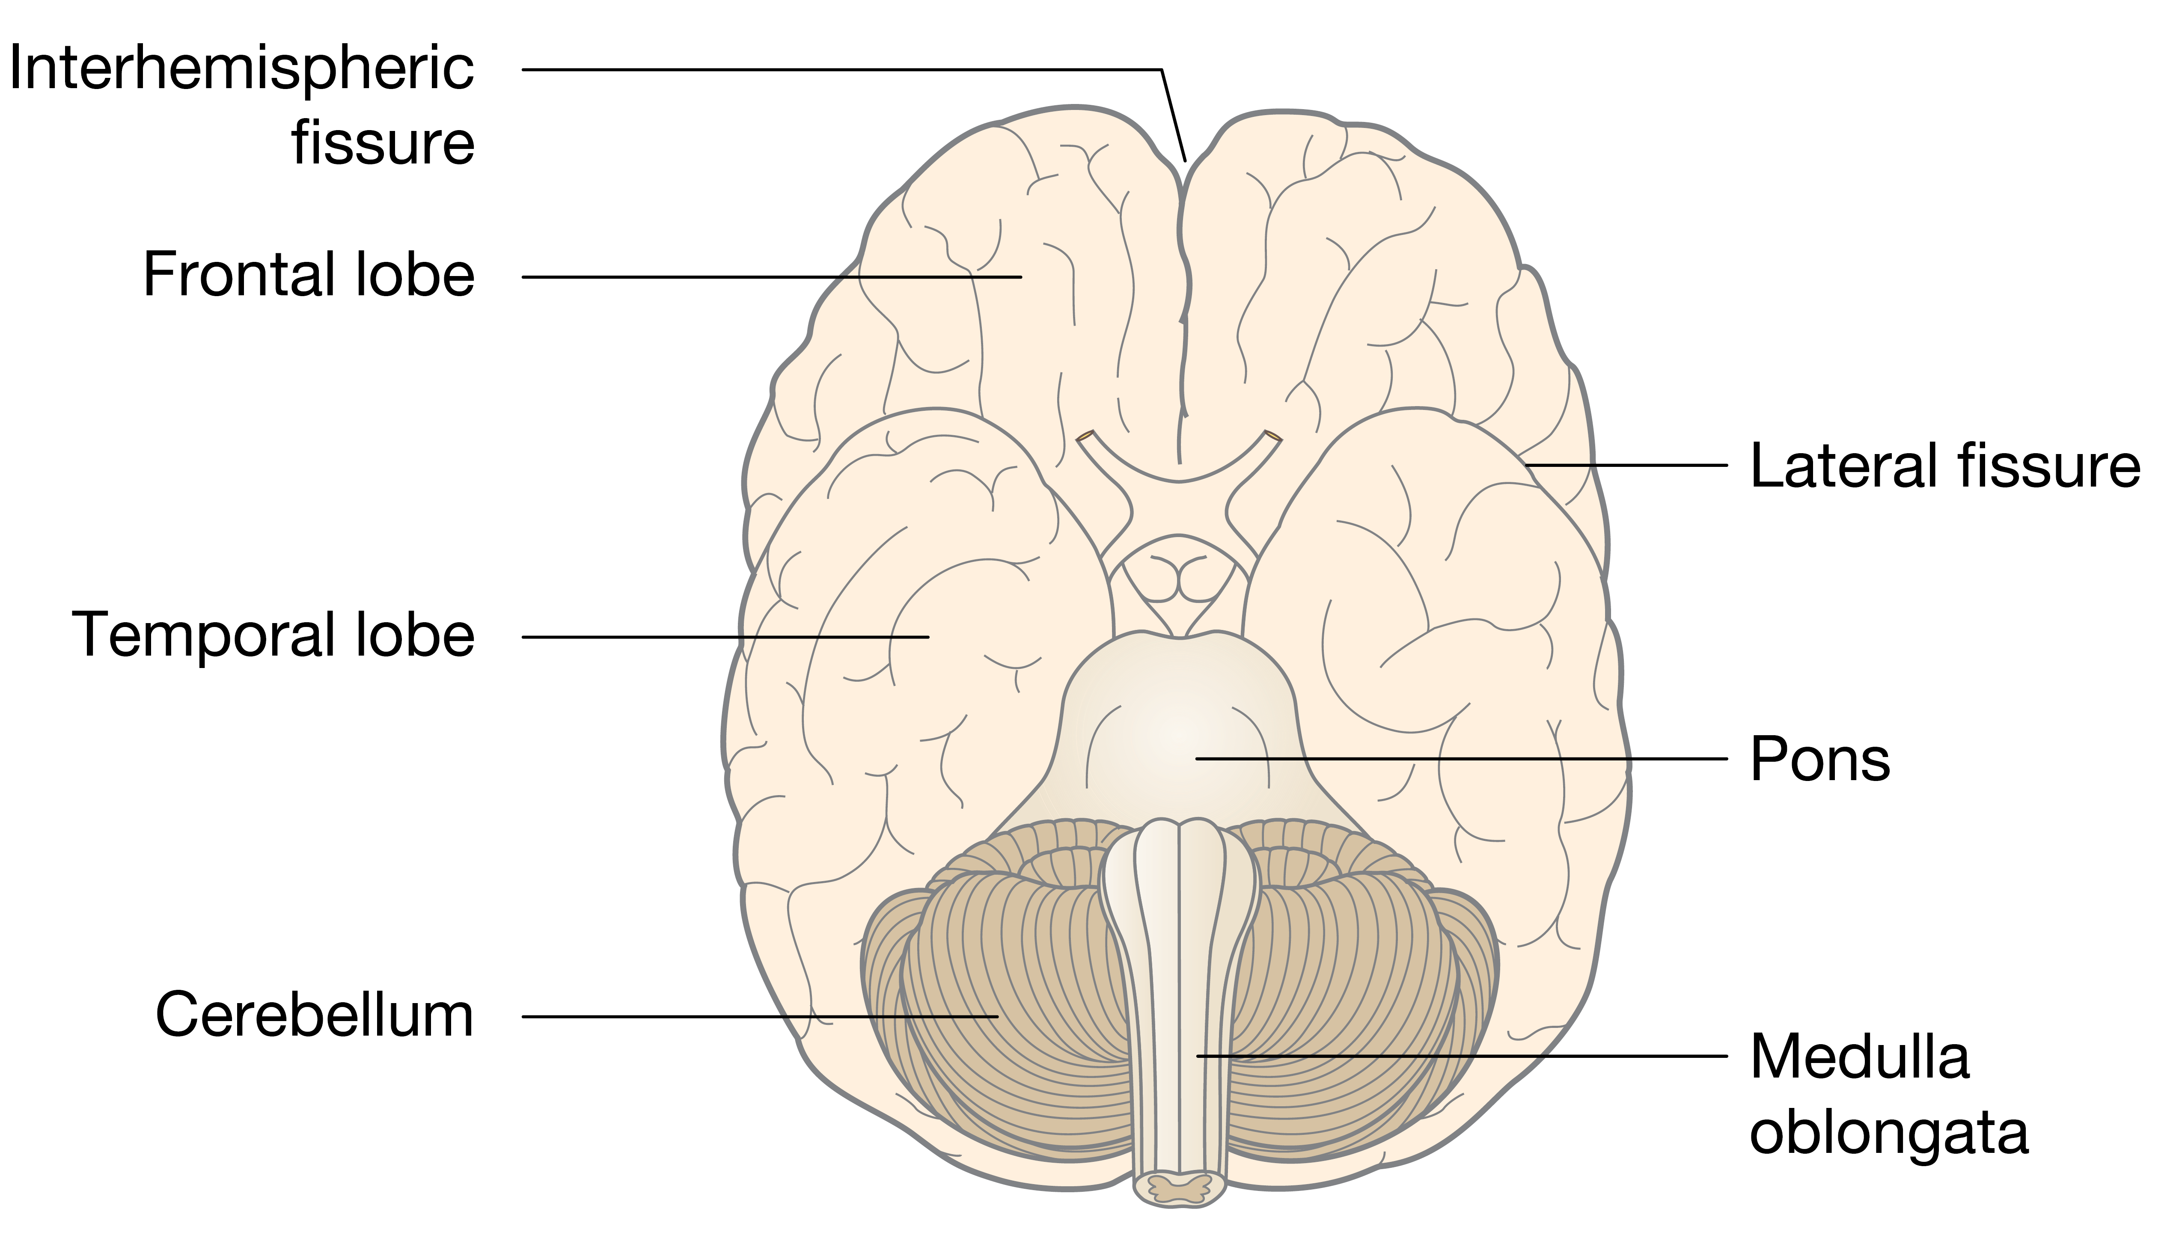
Cranial nerves
Olfactory
Optic
Oculomotor
Trochlear
Trigeminal
Abducens
Facial
Vestibulocochlear
Glossopharyngeal
Vagus
Accessory
Hypoglossal
On
Occasion
Our
Trusty
Truck
Acts
Funny
Very
Good
Vehicle
Any
How
Trigeminal

Slide 8
The spinal cord and body segmentation
Adult dermatome pattern

Slide 9
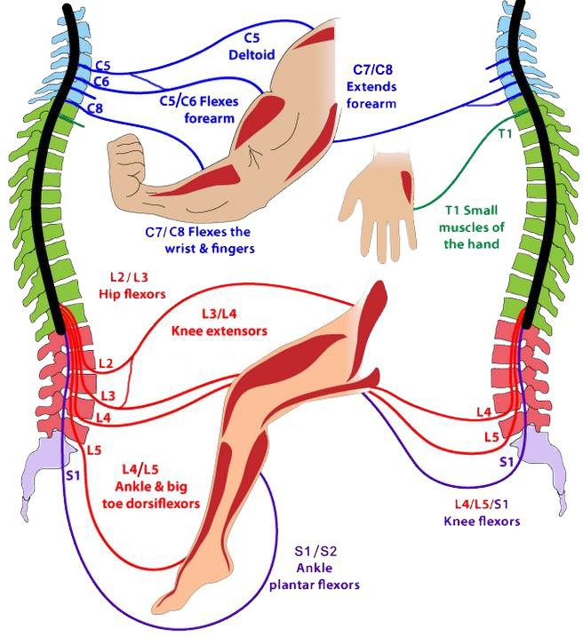
Dermatome vs Myotome
Adult dermatome pattern
Adult myotome pattern

Slide 10
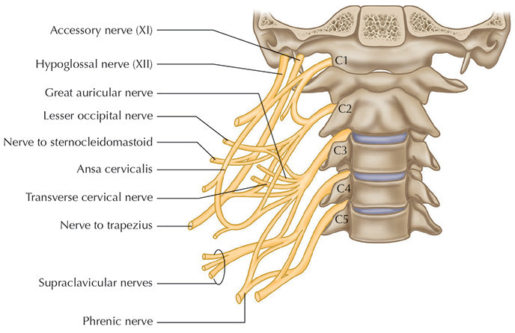
Nerve plexuses
Spinal nerves can intermingle into plexuses
  Neuropathies of the plexuses can have atypical symptoms
Cervical plexus
  C1-C4
  Phrenic nerve (C4) controls the diaphragm (motor)
Brachial plexus
  C5-T1 (sometimes C4, rarely T2)
  Divided in superior (C5-C6), middle (C7) and inferior trunks (C8-T1)
  Innervation of extensor and flexor muscles of the arm
Lumbosacral plexus
  L2-L4 (Lumbar plexus), ventral and medial thigh muscles
  L4-S3 (Sacral plexus), dorsal thigh, all leg and foot muscles and gluteal muscles

Slide 11
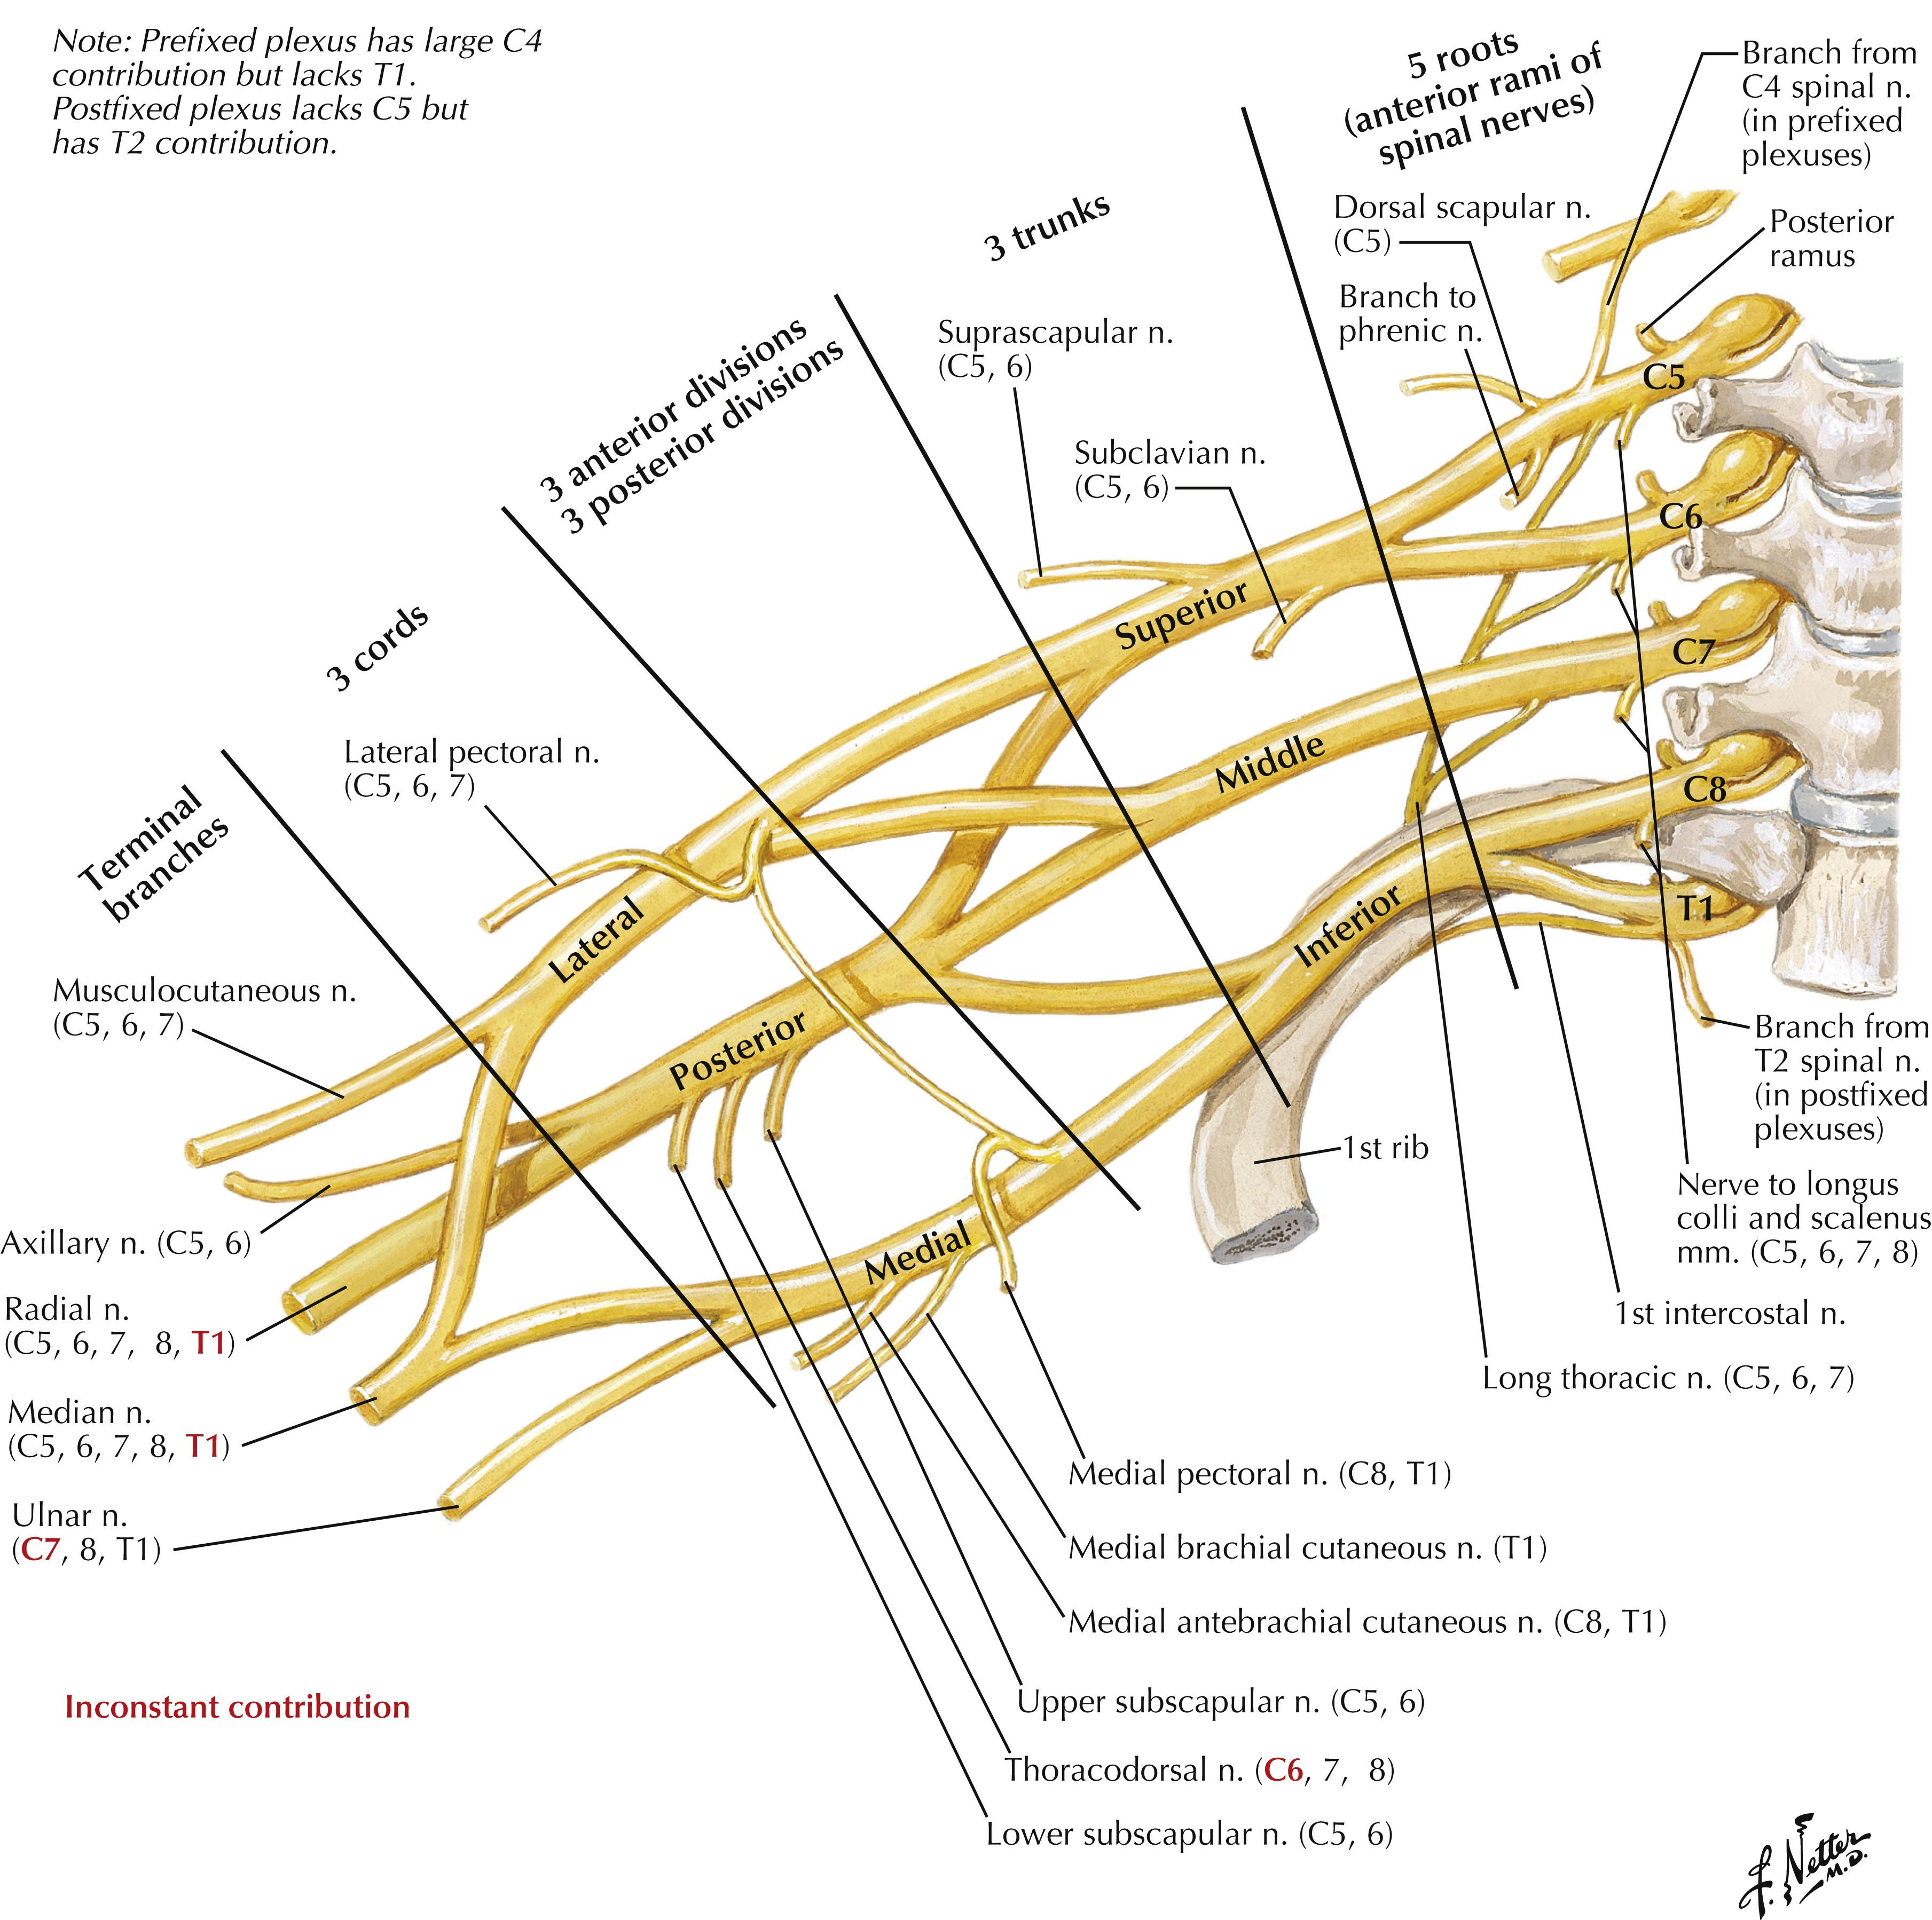
Nerve plexuses
Spinal nerves can intermingle into plexuses
  Neuropathies of the plexuses can have atypical symptoms
Cervical plexus
  C1-C4
  Phrenic nerve (C4) controls the diaphragm (motor)
Brachial plexus
  C5-T1 (sometimes C4, rarely T2)
  Divided in superior (C5-C6), middle (C7) and inferior trunks (C8-T1)
  Innervation of extensor and flexor muscles of the arm
Lumbosacral plexus
  L2-L4 (Lumbar plexus), ventral and medial thigh muscles
  L4-S3 (Sacral plexus), dorsal thigh, all leg and foot muscles and gluteal muscles

Slide 12
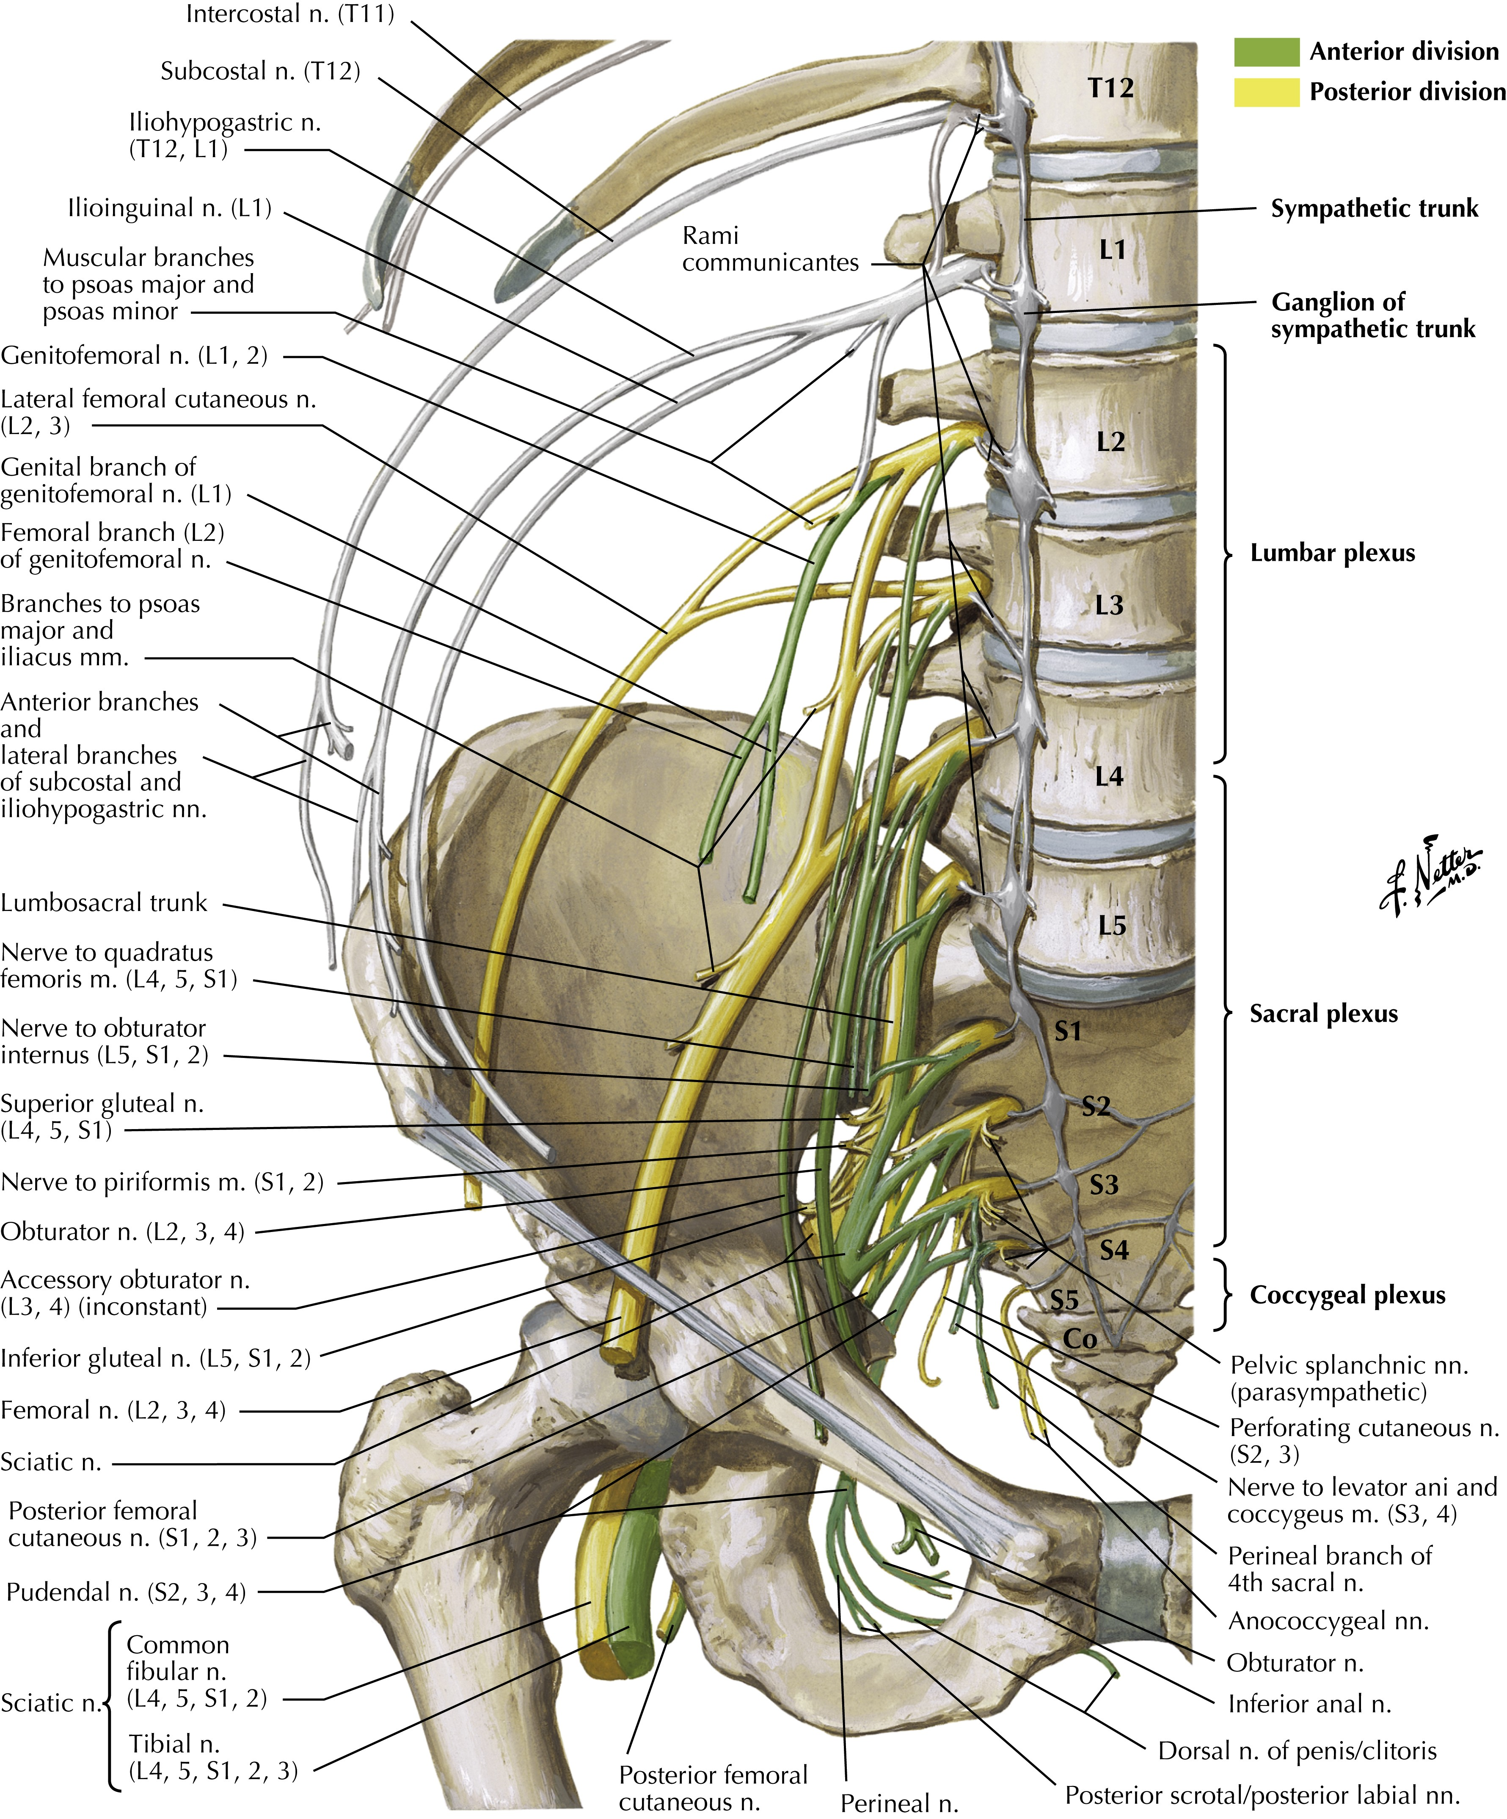
Nerve plexuses
Spinal nerves can intermingle into plexuses
  Neuropathies of the plexuses can have atypical symptoms
Cervical plexus
  C1-C4
  Phrenic nerve (C4) controls the diaphragm (motor)
Brachial plexus
  C5-T1 (sometimes C4, rarely T2)
  Divided in superior (C5-C6), middle (C7) and inferior trunks (C8-T1)
  Innervation of extensor and flexor muscles of the arm
Lumbosacral plexus
  L2-L4 (Lumbar plexus), ventral and medial thigh muscles
  L4-S3 (Sacral plexus), dorsal thigh, all leg and foot muscles and gluteal muscles

Slide 13
Autonomous nervous system

Slide 14
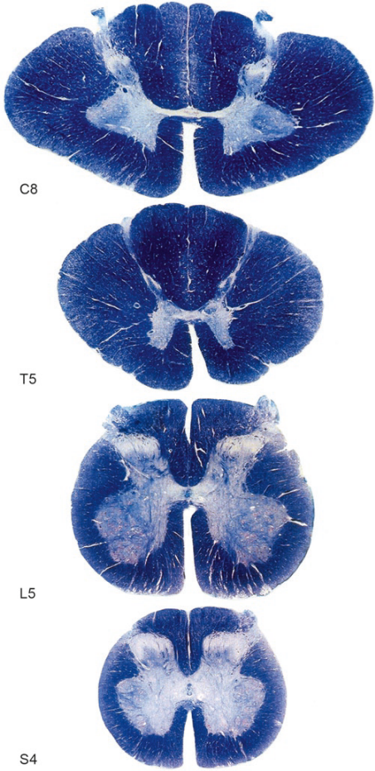
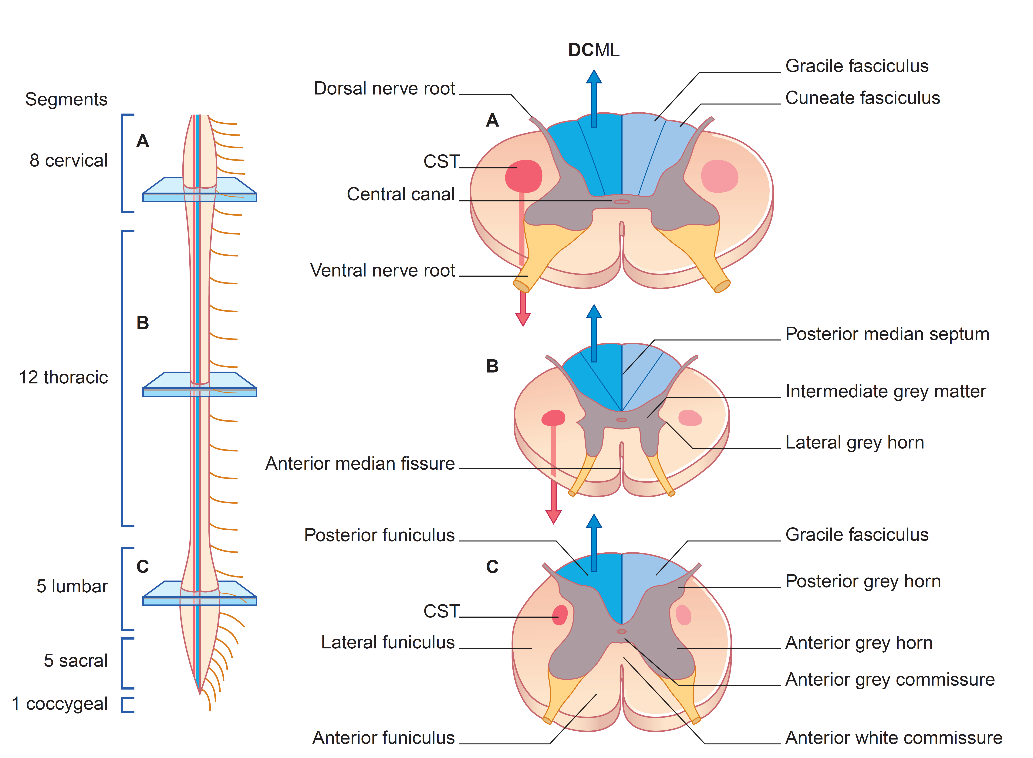
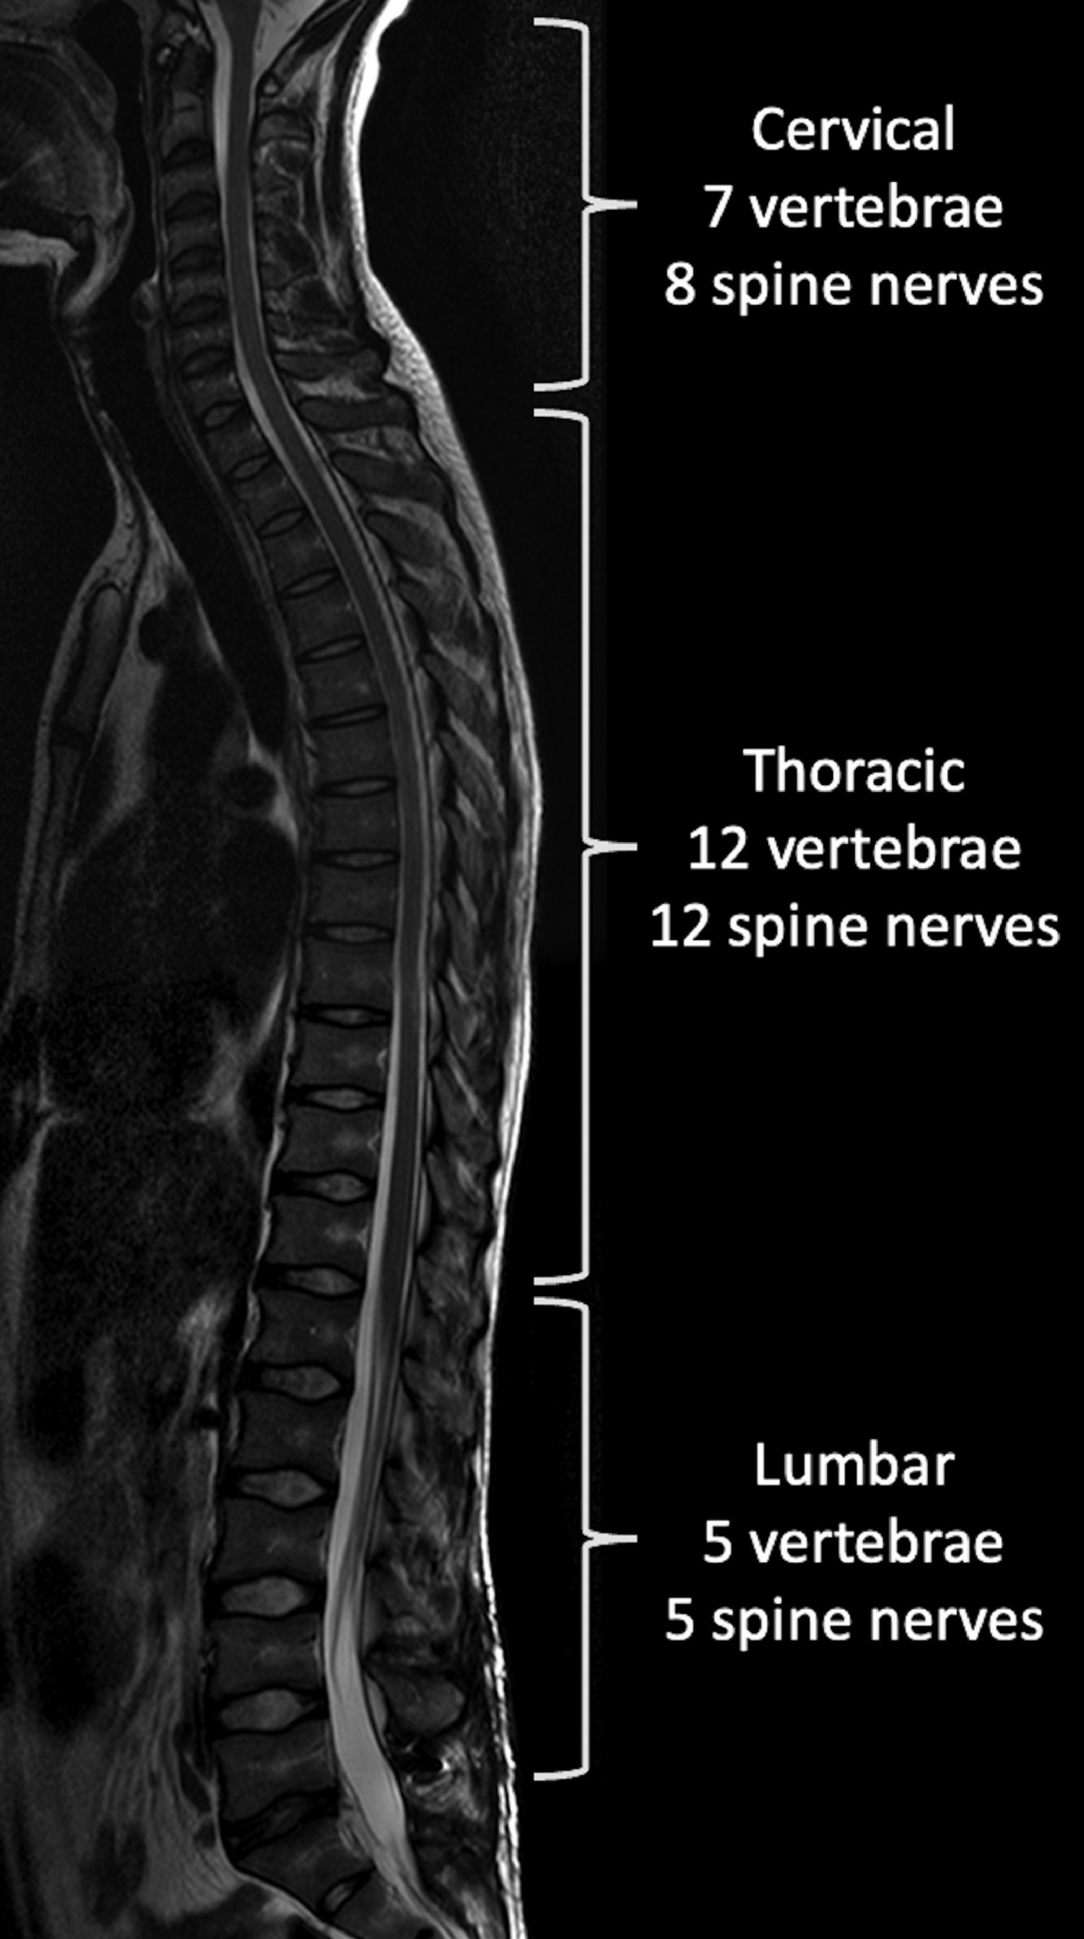
The CNS - Spinal Cord

Slide 15
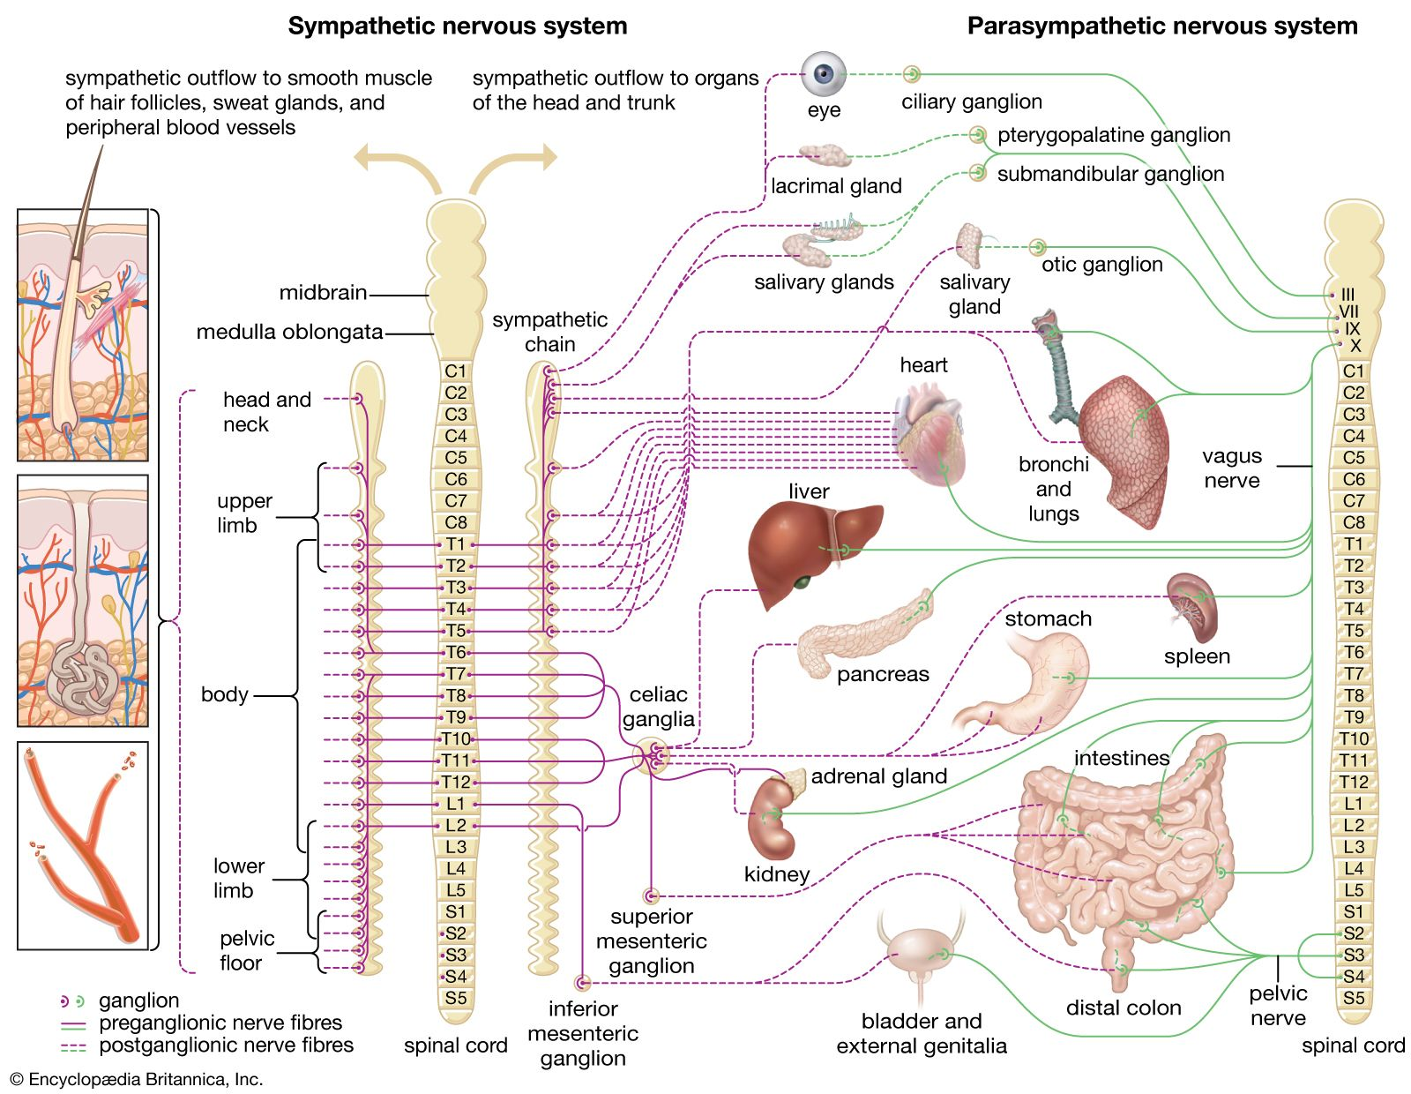
Sympathetic and parasympathetic systems
The parasympathetic system regulates “resting” autonomous body functions (e.g. digestion, renal secretion, etc.)
The sympathetic system regulates “fight-or-flight” responses (e.g. pupil dilation, increased hearth beat, bronchial dilation, sweating, etc.)

Slide 16
Peripheral ganglia
A
B
C
Ganglion: a collection of neuronal cell bodies in a defined structure
Preganglionic neurons in the CNS
  Parasympathetic → S2 - S4 spinal regions and brainstem (cranial nerves)
  Sympathetic → T1 - L2 spinal regions
Peripheral postganglionic neurons
  Synapse onto target tissues
  Cell bodies within ganglion
  Cell bodies within the target organ
CNS

Slide 17
Peripheral ganglia
Sympathetic chain ganglia
  Interconnected ganglia along the outside of the spinal cord
Sympathetic collateral ganglia
  Celiac
  Superior mesenteric
  Inferior mesenteric
Parasympathetic terminal ganglia
  Near target organs in the head
  Within the tissue walls of thorax, abdomen and pelvis

Slide 18
Peripheral ganglia

Slide 19

Neurotransmitters of the autonomic system
Acetylcholine
  All preganglionic neurons, both sympathetic and parasympathetic
  All parasympathetic postganglionic neurons
  Some sympathetic neurons
Noradrenaline
  Most postganglionic sympathetic neurons
Important pharmacological aspect

Slide 20
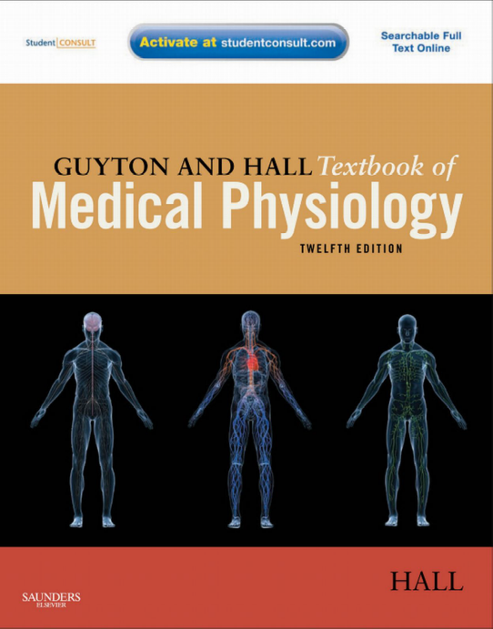
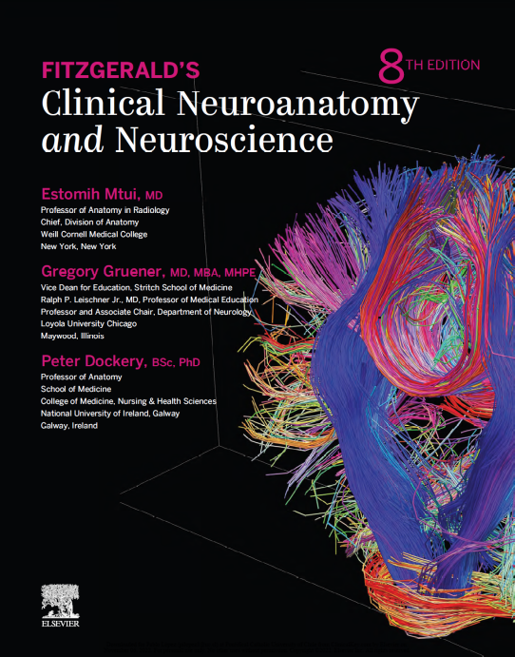
Questions?
For follow-up questions:
vincenzo.mastrolia@kcl.ac.uk
Specific reading:
  Guyton and Hall - Textbook of Medical Physiology 12th ed (2011) ISBN: 978-0-8089-2400-5
  Fitzgerald's Clinical Neuroanatomy and neuroscience 8th ed (2021, Elsevier) ISBN: 9780702079092

